Slide 1
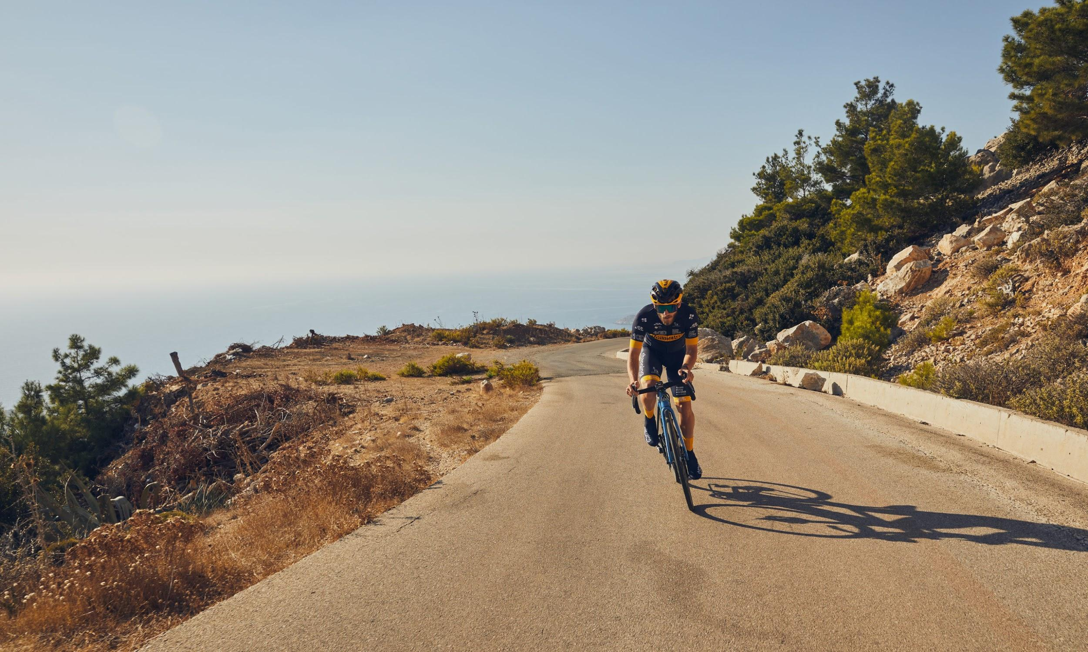
Cycling Analytics
Meeting May 05 2021

Slide 2

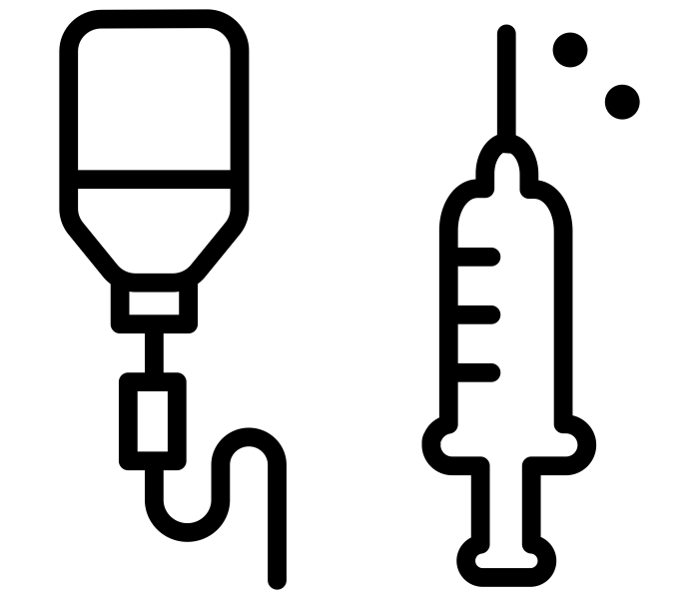


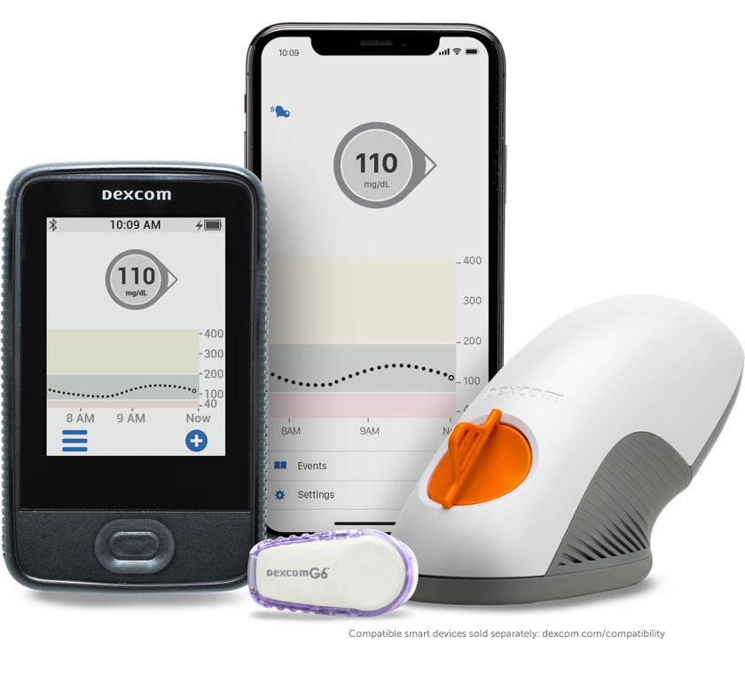
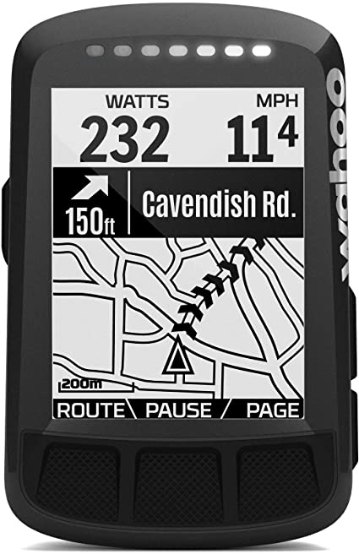
Recap: TNN data of 11 athletes from Dec 2018 - Nov 2019
Cycling
Glucose
heart rate power bike computer
CGM
TrainingPeaks (sec)
Dexcom (5 min)

Slide 3
Objective
Support patients with Type 1 Diabetes (TNN riders) in glucose management during exercise
General insights in glucose levels in-, during- and after training sessions through descriptives
Association of training sessions with time spent in glucose levels
Predict future glucose levels based on current and past glucose and current and past exercise.

Slide 4
Objective
Support patients with Type 1 Diabetes (TNN riders) in glucose management during exercise
General insights in glucose levels in-, during- and after training sessions through descriptives
Association of training sessions with time spent in glucose levels
Predict future glucose levels based on current and past glucose and current and past exercise.

Slide 5
Association of training sessions with time spent in glucose levels
Relation between glucose (variability) and exercise variables on a training session level (each data point is one training session)
glucose = f(trainingpeaks, training session statistics, rider statistics)

Slide 6
Association of training sessions with time spent in glucose levels
Relation between glucose (variability) and exercise variables on a training session level (each data point is one training session)
glucose = f(trainingpeaks, training session statistics, rider statistics)
TrainingPeaks (5min): aggregate data over the entire training session
Aggregation functions: sum, mean, median, std, iqr, min, max, (entropy?)

Slide 7
Association of training sessions with time spent in glucose levels
Relation between glucose (variability) and exercise variables on a training session level (each data point is one training session)
glucose = f(trainingpeaks, training session statistics, rider statistics)
TrainingPeaks (5min): aggregate data over the entire training session
Aggregation functions: sum, mean, median, std, iqr, min, max, (entropy?)
Training session statistics: e.g. Training Stress Score (TSS), Chronic Training Load (CTL), Acute Training Load (ATL), etc.
Can be easily calculated from power during training sessions (and in combination with statistics from previous training sessions (!) → time series split)

Slide 8
Association of training sessions with time spent in glucose levels
Relation between glucose (variability) and exercise variables on a training session level (each data point is one training session)
glucose = f(trainingpeaks, training session statistics, rider statistics)
TrainingPeaks (5min): aggregate data over the entire training session
Aggregation functions: sum, mean, median, std, iqr, min, max, (entropy?)
Training session statistics: e.g. Training Stress Score (TSS), Chronic Training Load (CTL), Acute Training Load (ATL), etc.
Can be easily calculated from power during training sessions (and in combination with statistics from previous training sessions (!) → time series split)
Rider statistics: weight, VO2%max, HbA1c, etc.

Slide 9
Association of training sessions with time spent in glucose levels
Relation between glucose (variability) and exercise variables on a training session level (each data point is one training session)
glucose = f(trainingpeaks, training session statistics, rider statistics)
TrainingPeaks (5min): aggregate data over the entire training session
Aggregation functions: sum, mean, median, std, iqr, min, max, (entropy?)
Training session statistics: e.g. Training Stress Score (TSS), Chronic Training Load (CTL), Acute Training Load (ATL), etc.
Can be easily calculated from power during training sessions (and in combination with statistics from previous training sessions (!) → time series split)
Rider statistics: weight, VO2%max, HbA1c, etc.
Glucose: percentage of time in a training session spent in glucose levels
L2 hypo, L1 hypo, normal, L1 hyper, L2 hyper
Note: only value every 5 min → impute on a minute level?

Slide 10
Association of training sessions with time spent in glucose levels
Correlation plots
Models:
Lasso
Gradient boosting + SHAP
Sub-analysis
Run model for all athletes combined and for every athlete individually
Can use this information in the next steps

Slide 11
Predicting future glucose
Model to predict future glucose, based on past glucose and past exercise values
Aggregate past glucose and exercise with the same aggregation functions:
sum, mean, median, std, iqr, min, max
Potentially add expected training session statistics and rider statistics as independent variables
New prediction every 5 min?
If every 1 min, linearly interpolate glucose values
Similar models and sub-analyses as in previous steps
Model: lasso, gradient boosting + SHAP
Sub-analysis: Run model for all athletes combined and for every athlete individually

Slide 12
Predicting future glucose
Model to predict future glucose, based on past glucose and past exercise values
Train-val-test split:
athletes always in separate partitions?
probably big variance among athletes so then model does not generalize

